Slide 1
First Performance Analysis of MAD-NG Embedded Tracing JIT Compiler
Aurelien Bloch
Supervisor: Laurent Deniau
EPFL supervisor: Martin Odersky
Master thesis, 11 September 2018

Slide 2
Outline
Introduction
LuaJIT
Object Model
Conclusion and future work

Slide 3
Outline
Introduction
LuaJIT
Object Model
Conclusion and future work

Slide 4
Methodical Accelerator Design
Set of tools developed at CERN.
Study, simulate, optimize beam physics for particle accelerators.
MAD-X succeeding MAD-8 in 2002.
Written in C, C++, Fortan77 and Fortran90.
Command-line program that execute its custom scripting language.
Single global workspace.
No function but a simple macro system.
High-level commands customized by the user.
Deferred expressions are heavily used everywhere.
Difficult to improve and maintain.
Tightly coupled module.
Unexpected side effect.
Notes:
MAD or Methodical Accelerator Design is a complete set of tools bundle together and developed at CERN to design, study, simulate and optimize beam physics for particle accelerators. Its current version is called MAD-X. It was first released in 2002 and is the successor of MAD-8. Its source code is mainly written in C, C++, Fortan77 and Fortran90.
It presents itself as a command-line program that reads and execute its custom scripting language. This language has the particularity of having a single workspace where everything is global. There is no function but a simple macro system. Most of the functionalities are provided through high-level commands that can be customized by the user.
Deferred expressions are heavily used everywhere. This code has been internally known to be difficult to maintain and improve. In additions of that, developing new functionality for it takes a significant amount of time due to the fact that module are tightly coupled and modification on its big code base can have unexpected side effect if the developer is not careful. The need for consolidation plus the rise of efficient and modern languages making the development faster and more flexible triggered a new redesign of the MAD application called MAD-NG.

Slide 5
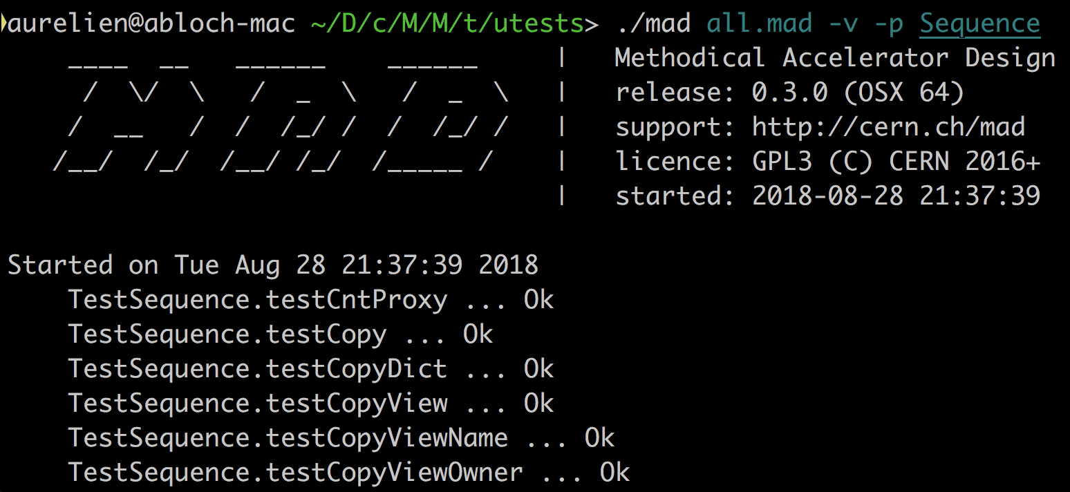
MAD Next Generation
Simple scripting language to offer easier and faster development.
Well-compartmented and modular design for scalability.
At least as performant as MAD-X.
Keep the high level command philosophy.

Slide 6
MAD Next Generation
MAD patch
MAD extensions
Lua equivalent
! single line comment
! number concatenation creates a range
a = 0..-1e6..-1
for _,v in ipairs(1..1e8..0.1) do a = v end
! local ‘in’ table
local sin, cos, tan in math
! lambda syntax
f = \x x*x
f = \x -> x*x
f = \x => a = x * a return a end
-- single line comment
-- number concatenation creates a string
a = 0 .. -1e6 .. -1 – need space
a = range(0,-1e6,-1)
for _,v in ipairs(range(0,-1e6,-1)) do a = v end
-- error prone
local sin, cos, tan = math.sin, math.tan,
math.cos
-- lambda syntax
f = function (x) return x*x end
f = function (x) return x*x end
f = function (x) a = x * a return a end

Slide 7
MAD Next Generation
Module Hierarchy

Slide 8
Lua programming language
Designed by a team at PUC-Rio
Authors claims: powerful, efficient, lightweight, embeddable scripting language.
Supports:
procedural programming,
object-oriented programming,
functional programming,
data-driven programming.
combines :
simple procedural syntax,
powerful data description,
associative arrays,
extensible semantics (Metatable, Metamethods).
Incremental garbage collection.
Dynamically typed.
Interpret bytecodes using a register-based VM.

Slide 9
LuaJIT Tracing JIT Compiler
TODO

Slide 10
Problem description
TODO

Slide 11
Project goals
TODO

Slide 12
Outline
Introduction
LuaJIT
Object Model
Conclusion and future work

Slide 13
LuaJIT
TODO

Slide 14
LuaJIT
Frontend

Slide 15
LuaJIT
Bytecode interpreter

Slide 16
LuaJIT
Library

Slide 17
LuaJIT
FFI

Slide 18
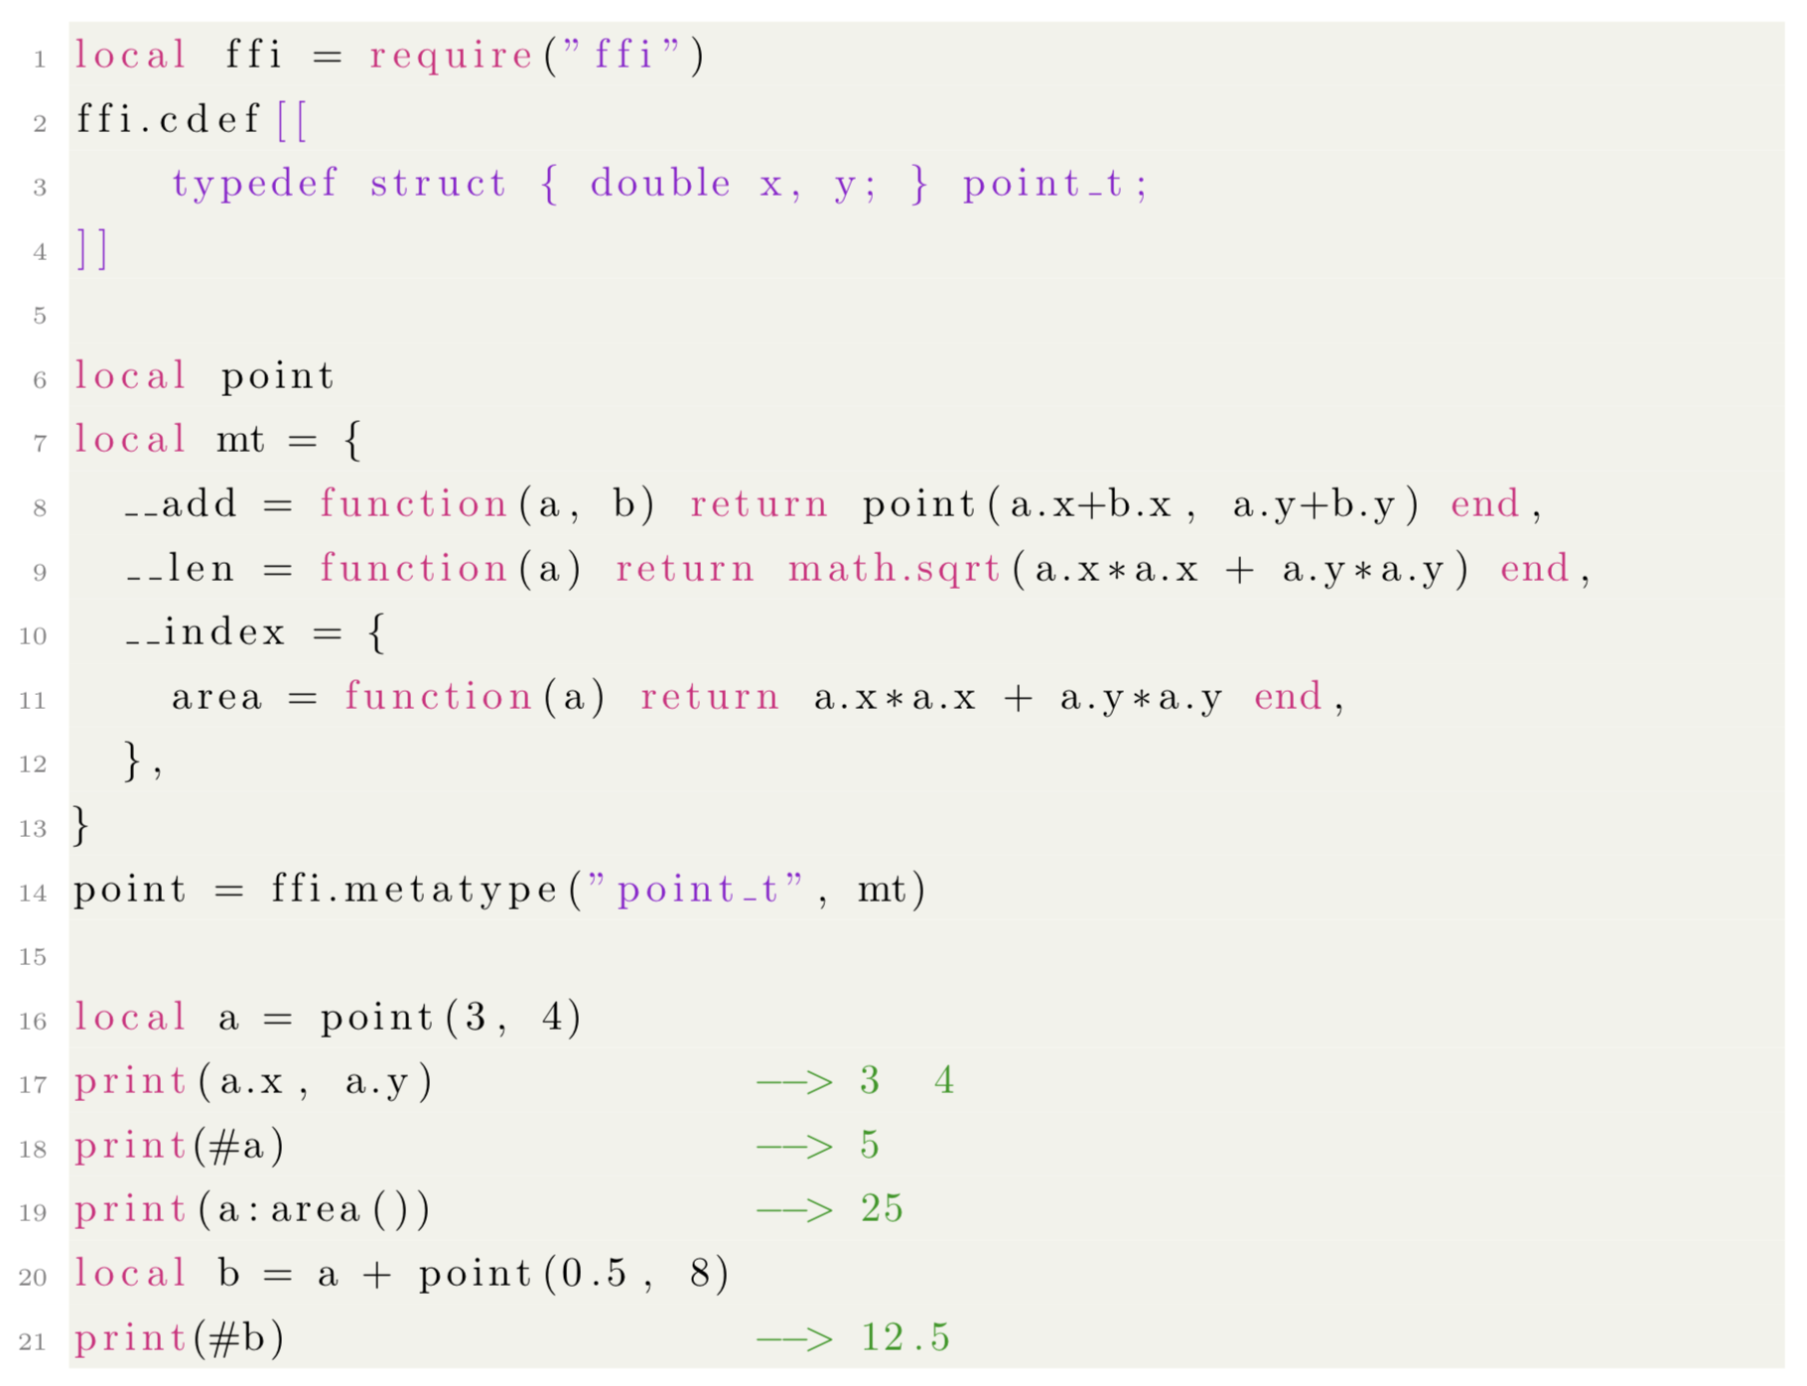
LuaJIT
FFI example 1

Slide 19
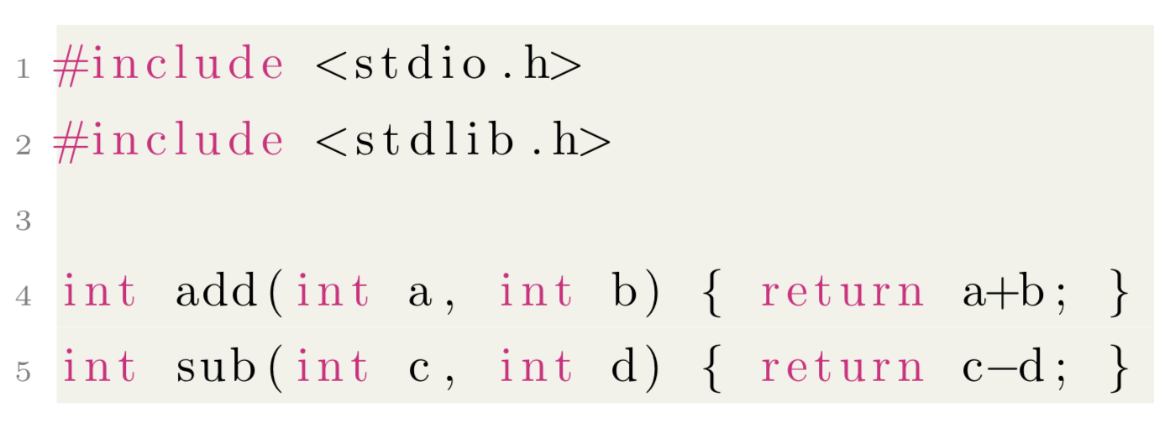
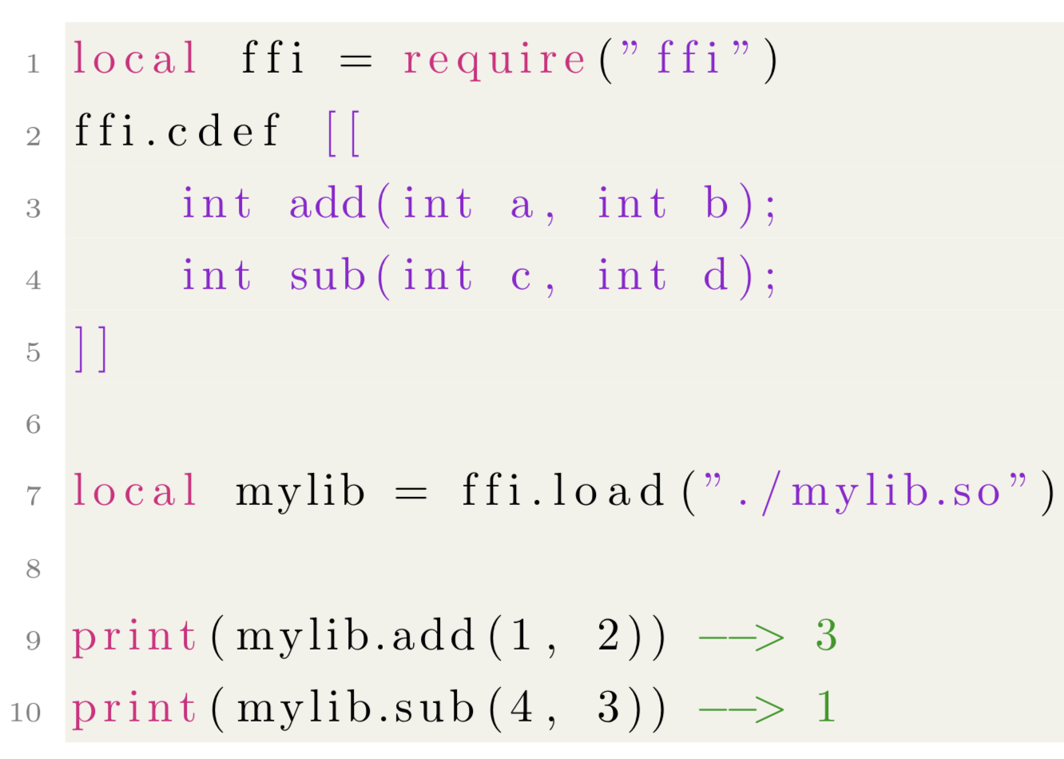
LuaJIT
FFI example 2

Slide 20
LuaJIT
JIT

Slide 21
LuaJIT
Trace recorder

Slide 22
LuaJIT
Trace optimizer

Slide 23
LuaJIT
Trace assembler

Slide 24
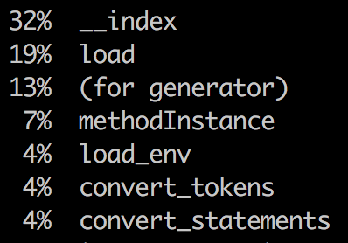
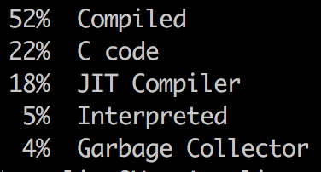
LuaJIT
Tool: profiler

Slide 25
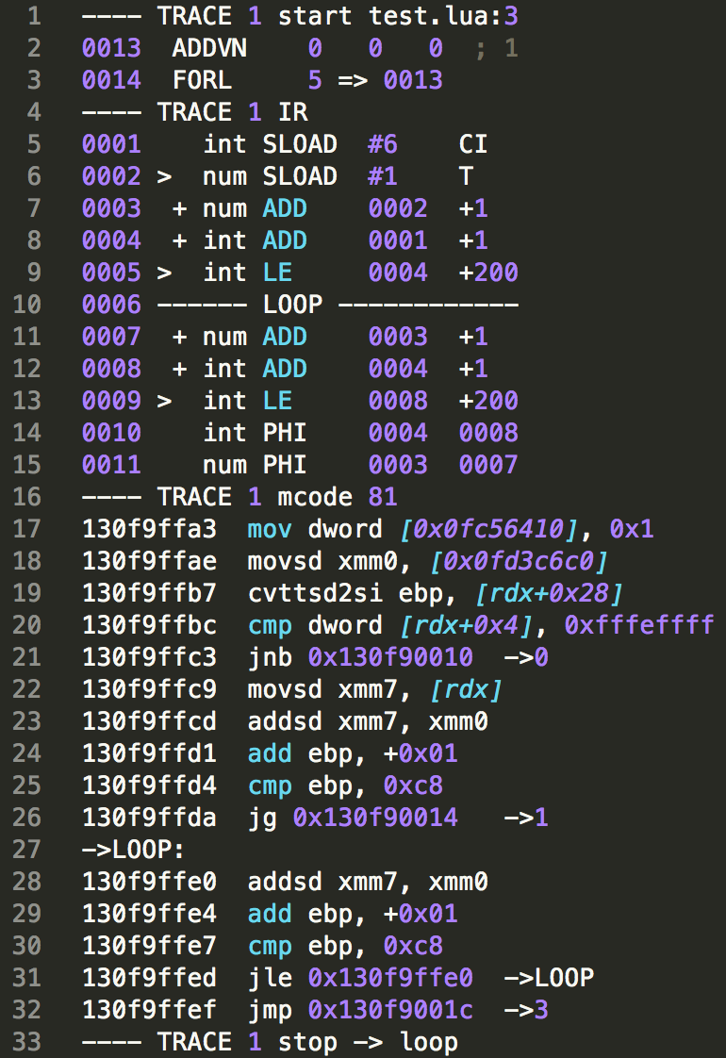
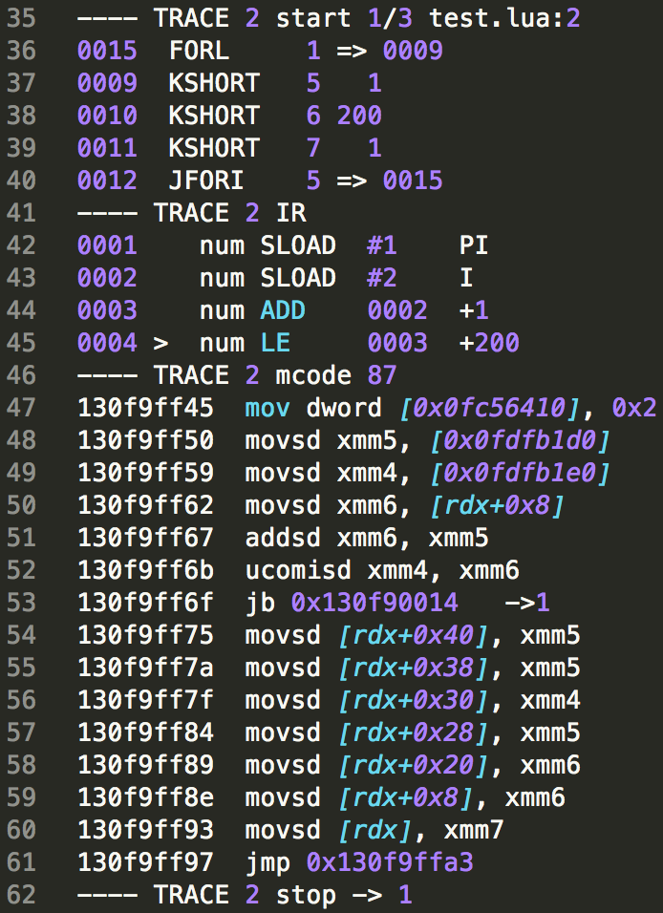
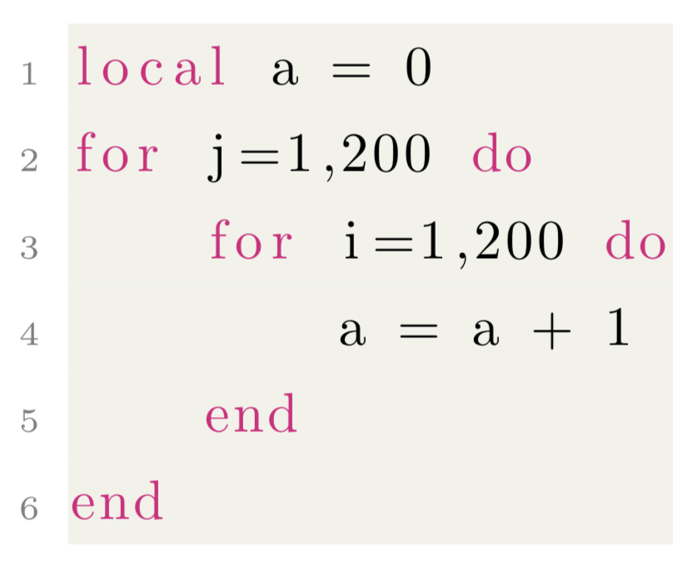
LuaJIT
Tool: dump

Slide 26
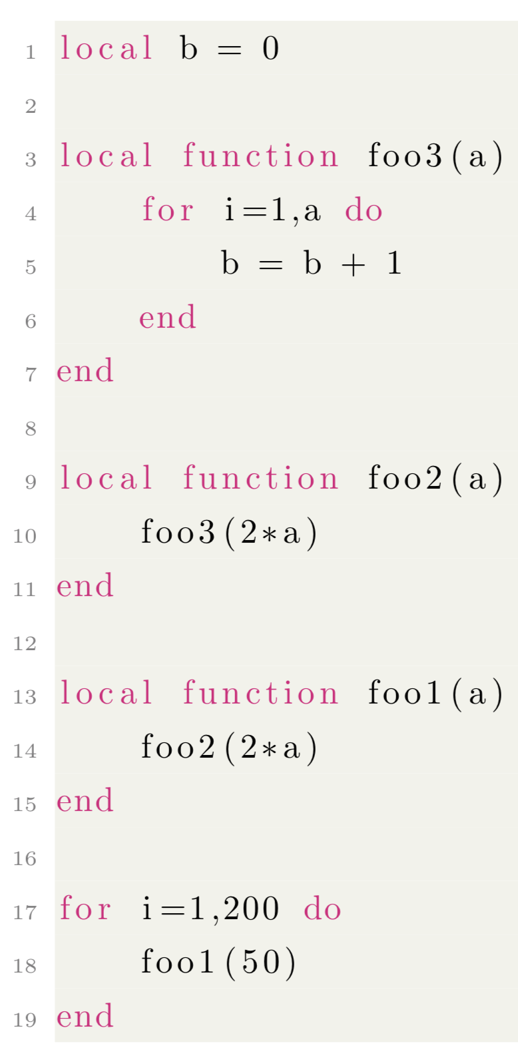
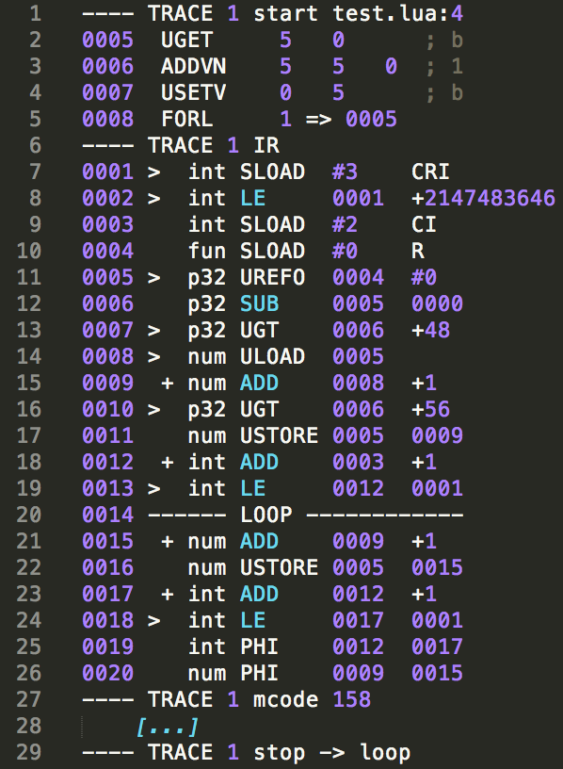
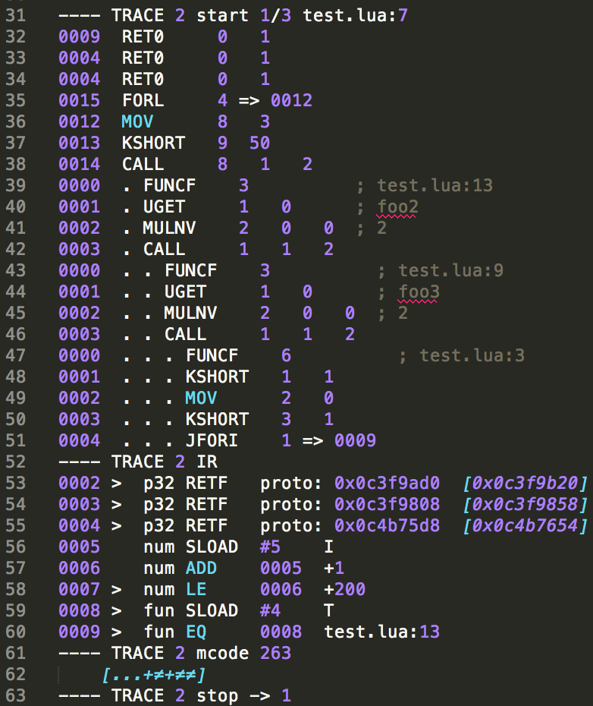
LuaJIT
Tool: dump

Slide 27
Outline
Introduction
LuaJIT
Object Model
Conclusion and future work

Slide 28
Object Model
TODO

Slide 29
Description
TODO

Slide 30
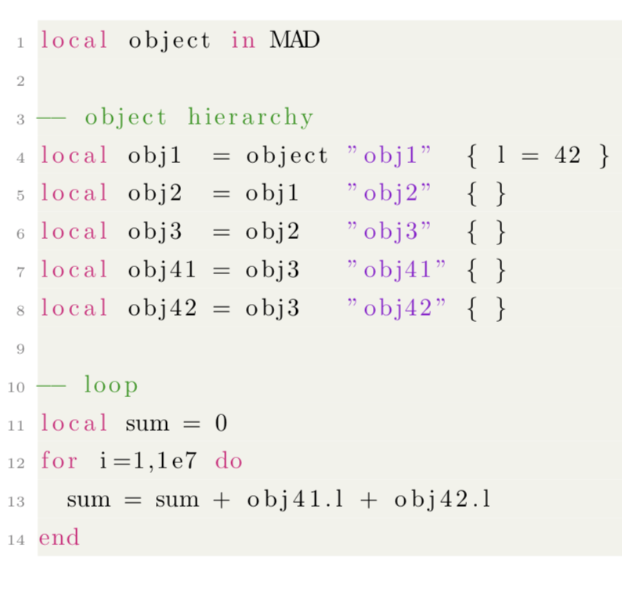
Performance analysis
Example 1
Obj1
l
Obj2
Obj3
Obj41
Obj42

Slide 31
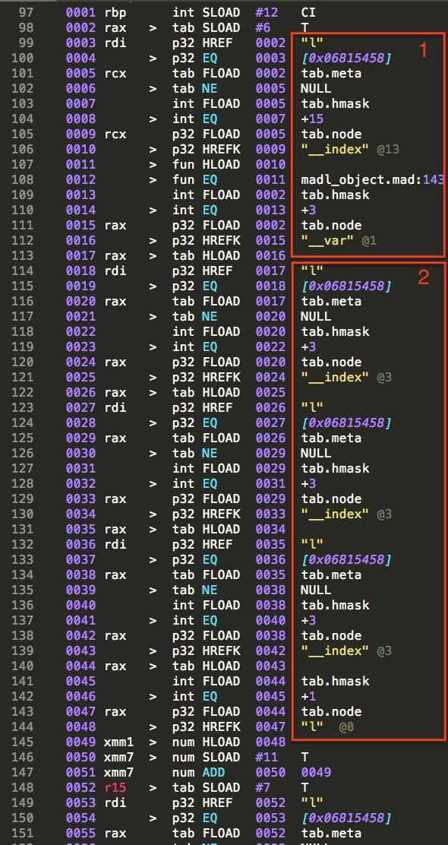
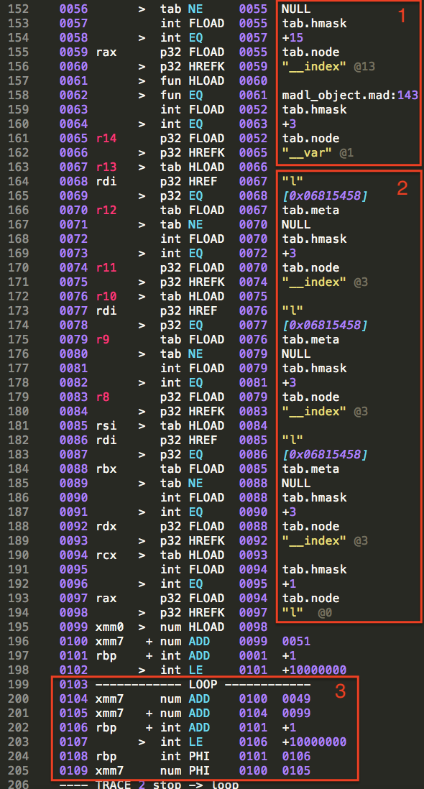
Performance analysis
Example 1

Slide 32
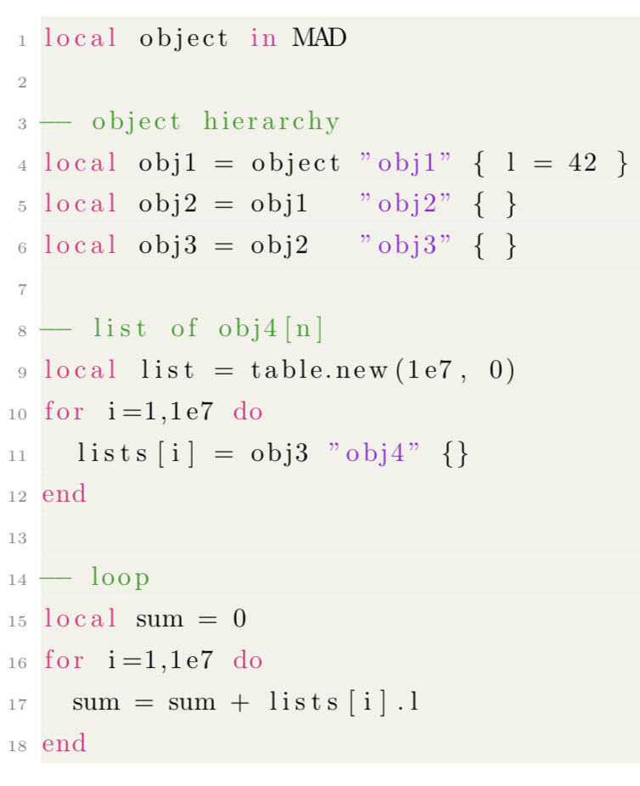
Performance analysis
Example 2
Obj1
l
Obj2
Obj3
List
Obj41
Obj42
Obj4[n]
[...]

Slide 33
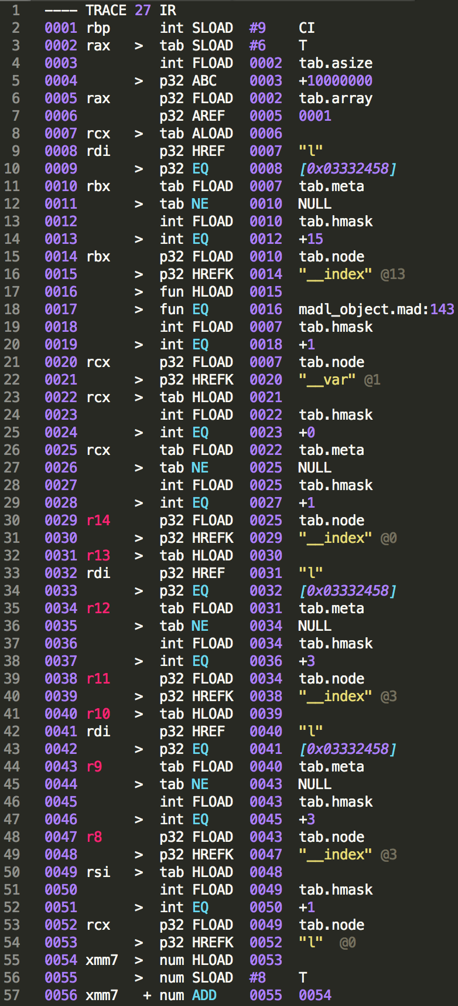
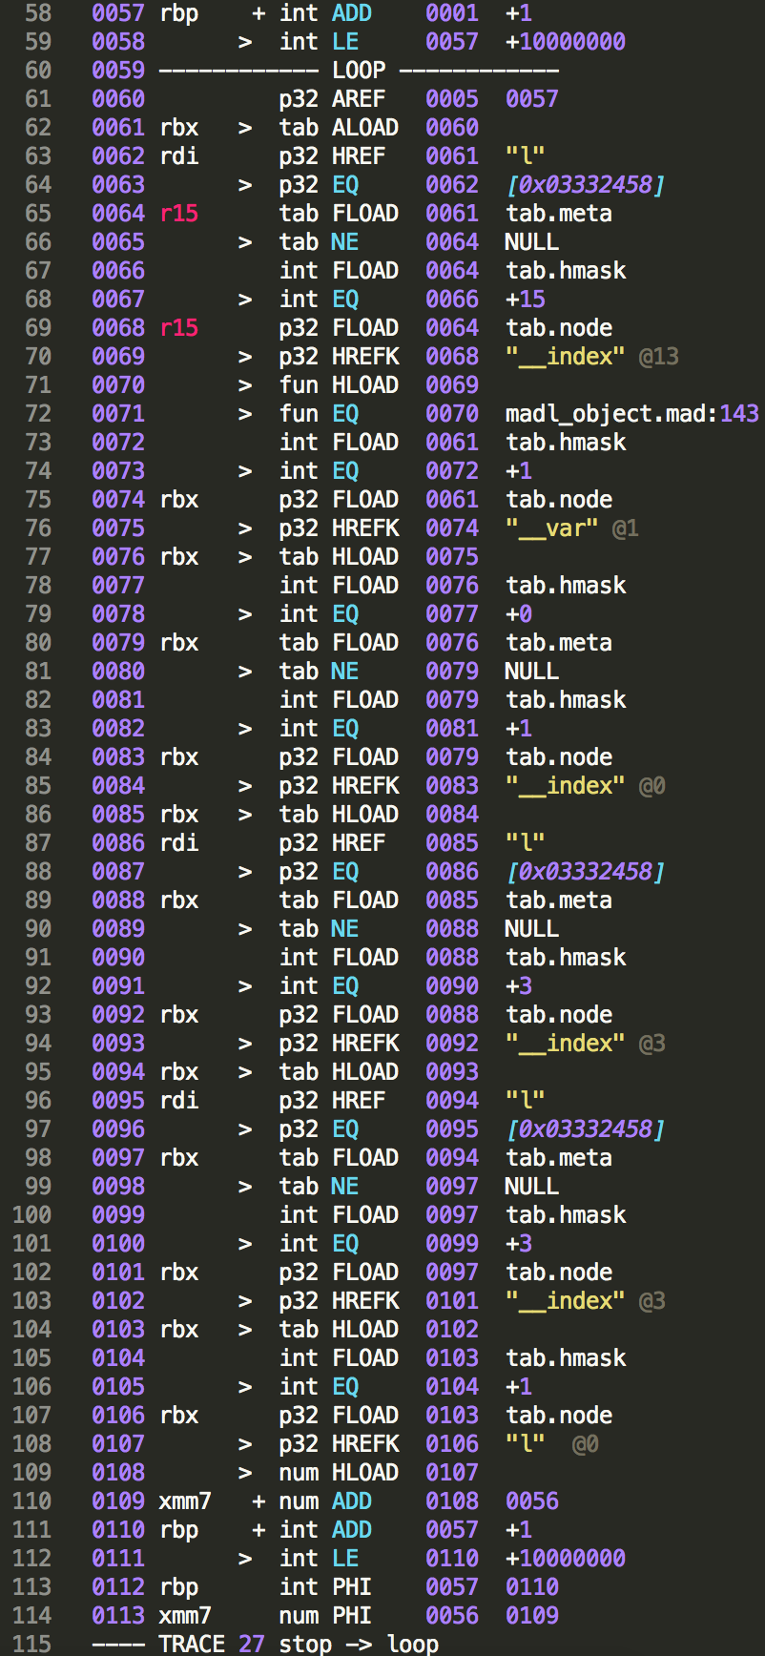
Performance analysis
Example 2

Slide 34
Possible explanations for performance hit
TODO

Slide 35
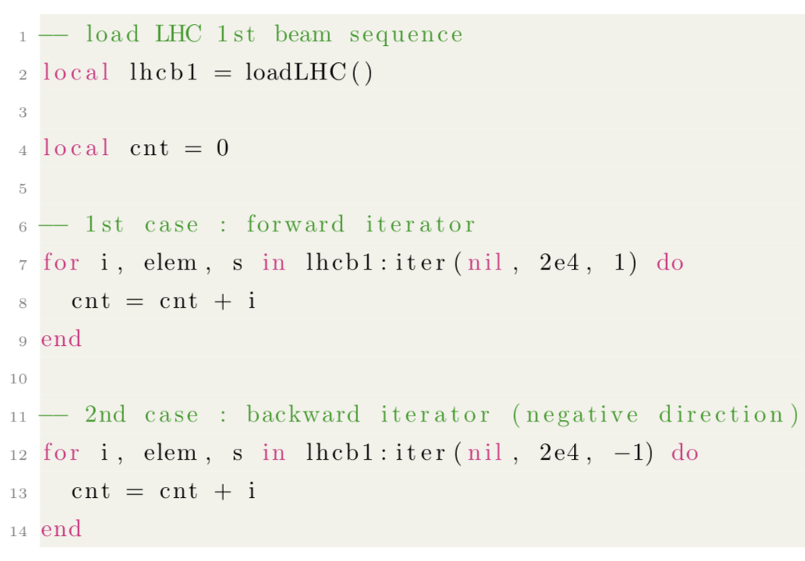
Sequence iterator
TODO

Slide 36
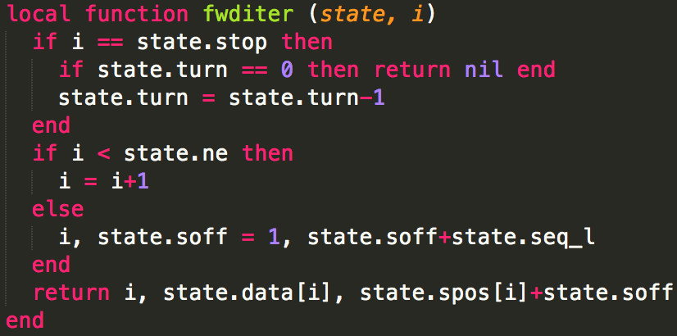
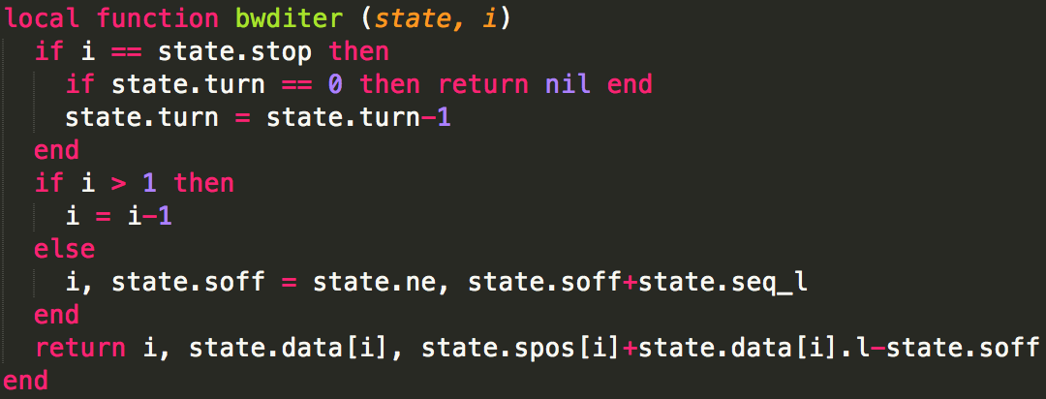
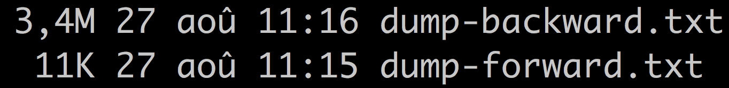
Sequence iterator
TODO

Slide 37
Alternative design
TODO

Slide 38
Outline
Introduction
LuaJIT
Object Model
Conclusion and future work

Slide 39
Conclusion and future work
TODO

